Slide 1

ICT 581 HTML5 and CSS3 with jQuery
Continuing Education
Day 3: Ajax, HTML forms and jQuery Events
Mostafa Mohamed, PhD, P.Eng.
Adjunct Professor,
Electrical and Software Engineering Department
Mostafa.Mohamed@ucalgary.ca
@ 2022

Slide 2
Previous Class
Document traversal
Using jQuery to manipulating web content
Working with CSS
Showing and hiding elements

Slide 3
Agenda
Ajax and Data Formats (XML, JSON)
HTML forms
jQuery Events
Reading:
https://www.w3schools.com/jquery/jquery_ref_ajax.asp

Slide 4
Ajax and Data Formats (XML, JSON)

Slide 5
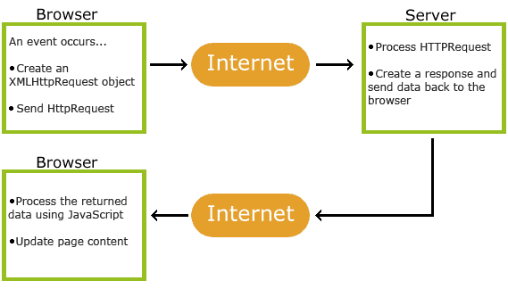
AJAX
Asynchronous JavaScript And XML
Ajax made a huge change in web development
You can get and post data between from your front-end to the server without reloading the page
This has a huge impact to the user experience
https://www.w3schools.com/js/js_ajax_intro.asp
Image source: https://www.w3schools.com/whatis/whatis_ajax.asp

Slide 6
JSON
[
{
"Name": "Mohamed",
"Phone": "403-888-7777",
"Email": "sam@server.com",
"Country": "Canada",
"Province": "AB",
"City": "Calgary",
"Address": "1 Country Hills Dr."
},
{
"Name": "Ali",
"Phone": "403-444-5555",
"Email": "ali@server.com",
"Country": "Canada",
"Province": "AB",
"City": "Calgary",
"Address": "10 Saddle town Dr."
}
]
JavaScript Object Notation
Of the most commonly used formats to transfer data on the web
JSON is a light weight and self-descripting format
[] used for arrays
{} used for objects
https://www.w3schools.com/whatis/whatis_json.asp

Slide 7
XML
<?xml version="1.0" encoding="UTF-8"?>
<student_list>
<student>
<name>Mohamed</name>
<phone>403-888-7777</phone>
<email>sam@server.com</email>
<country>Canada</country>
<province>AB</province>
<city>Calgary</city>
<address>1 Country Hills Dr.</ddress>
</student>
<student>
<name>Ali</name>
<phone>403-444-5555</phone>
<email>ali@server.com</email>
<country>Canada</country>
<province>AB</province>
<city>Calgary</city>
<address>10 Saddle town Dr.</address>
</student>
</student_list>
eXtensible Markup Language
One of the commonly used data exchange formats
Used to be the most used format before
Has syntax close to html tags
https://www.w3schools.com/whatis/whatis_xml.asp

Slide 8
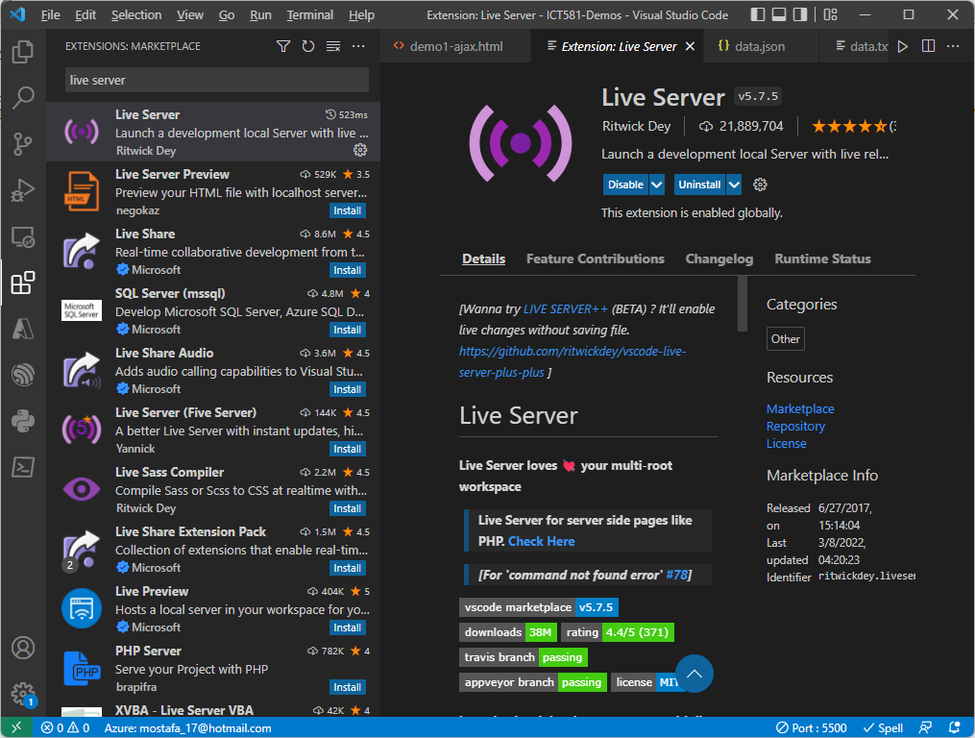
Install VS Code Extension
To develop using Ajax, the website should be hosted on a web server to send requests to it
An alternative is to install a development server on your local computer
“Live Server” is a VS Code extension that hosts your web contents and offers file reload on save
Right click any html page and select “Open with Live Server”

Slide 9
.load( url [, data ] [, complete ] )
Load data from the server and place the returned HTML into the matched elements.
url: the URL to which the request is sent.
data: Object or String to send to the server with the request.
complete: Function(), a callback function that is executed when the request completes.
// Load text data
$('#text_contents').load('data.txt');
See demo1-ajax-load.html
https://api.jquery.com/load/

Slide 10
jQuery.get( url [, data ] [, success ] [, dataType ] )
Gets data from the server using a HTTP GET request.
url: the URL to which the request is sent.
data: Object or String to send to the server with the request.
success: Function(), a callback function that is executed if the request succeeds.
datatype: the expected data format. Default: Intelligent Guess (xml, json, script, text, html).
See demo2-ajax-get-post.html
https://api.jquery.com/jQuery.get/

Slide 11
jQuery.post( url [, data ] [, success ] [, dataType ] )
Send data to the server using a HTTP POST request.
url: the URL to which the request is sent.
data: Object or String to send to the server with the request.
success: Function(), a callback function that is executed if the request succeeds.
datatype: the expected data format. Default: Intelligent Guess (xml, json, script, text, html).
$.post("/", { name: "Samy" });
See demo2-ajax-get-post.html
https://api.jquery.com/jQuery.post/

Slide 12
jQuery.ajax( url [, settings ] )
Perform an asynchronous HTTP (Ajax) request.
url: the URL to which the request is sent.
Settings: Object.
The most general Ajax request type
See demo3-ajax.html
https://api.jquery.com/jQuery.ajax/

Slide 13
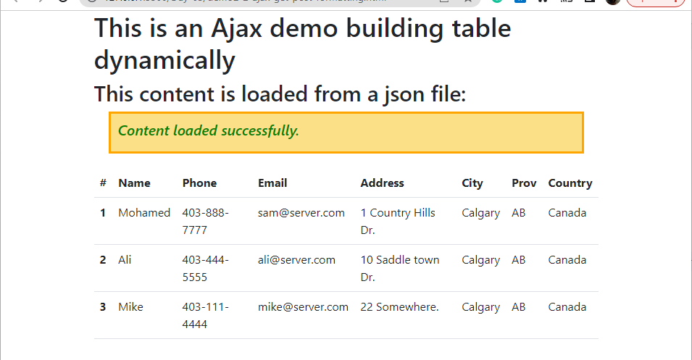
Using Bootstrap to style your contents
You can use Bootstrap to give you a professional looking web look.
See demo2-2-ajax-get-post-formatting.html
https://getbootstrap.com/

Slide 14
jQuery Forms
https://api.jquery.com/category/selectors/form-selectors/

Slide 15
jQuery( ":button" ) Selector
Selects all button elements and elements of type button.
$(":button").addClass("dark");
See demo4-forms.html
https://api.jquery.com/button-selector/

Slide 16
jQuery( ":checkbox" )
Selects all elements of type checkbox.
$(":checkbox").prop('checked', 'true');
https://api.jquery.com/checkbox-selector/

Slide 17
jQuery( ":input" )
Selects all input, textarea, select and button elements.
$( ":input" )
https://api.jquery.com/input-selector/

Slide 18
jQuery Events
https://api.jquery.com/category/events/

Slide 19
.bind( eventType [, eventData ], handler )
Attach a handler to an event for the elements.
eventType: one or more DOM event types, such as "click" or "submit”.
eventData: object containing data that will be passed to the event handler.
handler: Function, a function to execute each time the event is triggered.
$("#b1").bind("click", function () {
$('div').html('<h3>B1 clicked</h3>');
});
https://api.jquery.com/bind/

Slide 20
focus() and blur()
Focus: Bind an event handler to the "focus" JavaScript event, or trigger that event on an element.
Blur: Bind an event handler to the "blur" JavaScript event, or trigger that event on an element.
$('input:text').focus((event) => $(event.currentTarget).addClass('focus'));
$('input:text').blur((event) => $(event.currentTarget).removeClass('focus'));
https://api.jquery.com/focus/
https://api.jquery.com/blur/

Slide 21
Summary
Ajax and Data Formats (XML, JSON)
HTML forms
jQuery Events

Slide 22
Assignment 1
Use demo6-ajax-api.html as a starting point
Create a page that shows the current time, sunrise and sunset times, change the page background based on the current time. E.g.: light blue for the morning and dark blue for the evening
Display the City, State/Province and Country
Show the current temperature, humidity, feels like, weather description
If it is too hot, show a worming message with reddish background, and same for the cold weather
Display an image and change it based on the condition. E.g.: clouds, raining, etc.
Add “Update” button to pull new weather data on click using jQuery

Slide 24
Thank you for attending today!!!
Mostafa Mohamed, PhD, P.Eng.
Mostafa.Mohamed@ucalgary.ca
WhatsApp: 403-966-8112

